Slide 1
BLINKIT DATASET
QUANSAH ABAIDOO MESHACH

Slide 2
INTRODUCTION
Hello And Welcome. In Today’s Presentation, I Am Excited To Take You Through This Bike Share Dataset.
I Am Really Excited To Be Doing This Presentation As It Has Given Me The Opportunity To Dive Into, And Gain Insightful Information About This Special Project

Slide 3
ABOUT ME
Hola, My Name Is Quansah Abaidoo Meshach, A Data Analyst And I Am Here Today To Take Us Through This Wonderful Presentation. Being A Data Analyst Hasn’t Being Easy Especially For Someone Without A Background In Computer Science Or Anything Relating To Data. However By The Grace Of God, Here We Are After 6 Solid Months. I Do Hope You Enjoy This Presentation And Oh Yh Let’s Have Fun Doing What We Love The Most. Let’s Goooooo

Slide 4
PROCESS
I am excited to state that, I took the necessary process in ensuring that this project has passed through the necessary steps and procedure before finally arriving at the final result.
First, I checked my individual columns for errors. I discovered during this phase that, Item fat content column contain errors so I worked on it by changing all “low fats”and “LFs” to “Low Fat” since its all the same. I then changed all “reg” to “Regular”. Before proceeding to load the data into power BI for my analysis and visuals.
I showcased a few of the visuals I got from my insights, the rest are in the form of slicers or cards.

Slide 5
BUSINESS QUESTIONS/KPIs
Total sales by item type
Sales by item fat contENT and outlet type
Total sales by outlet size
Sales by outlet location type
SALES BY ITEM FAT CONTENT
SALES BY OUTLET ESTABLISHMENT YEAR
AVERAGE SALES AND AVERAGE RATING BY ITEM TYPE
AVERAGE RATING
AVERAGE SALES
NUMBER OF ITEMS
TOTAL SALES

Slide 6
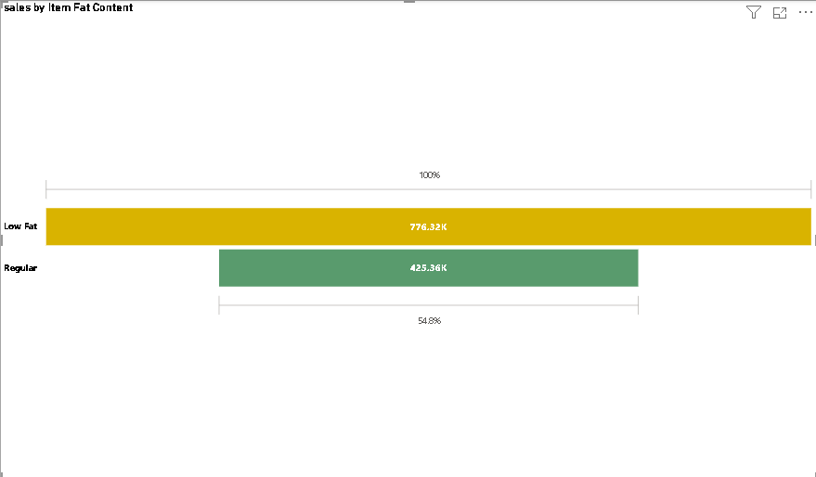
SALES BY ITEM FAT CONTENT
Here, we can se that low fat content items are in highdemand as against regular fat content items telling management to produce more of the low fat items as it is more preferred as against the regular fat content items

Slide 7
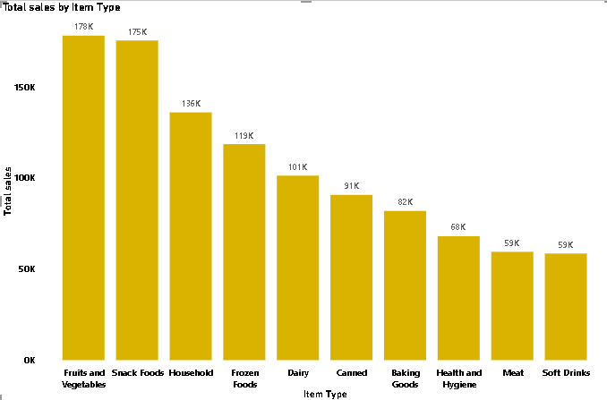
TOP 10 TOTAL SLES BY ITEM TYPE
At 178,124.08, Fruits and Vegetables had the highest Total sales and was 204.41% higher than Soft Drinks, which had the lowest Total sales at 58,514.17.
Fruits and Vegetables accounted for 16.68% of Total sales.
Across all 10 Item Type, Total sales ranged from 58,514.17 to 178,124.08

Slide 8
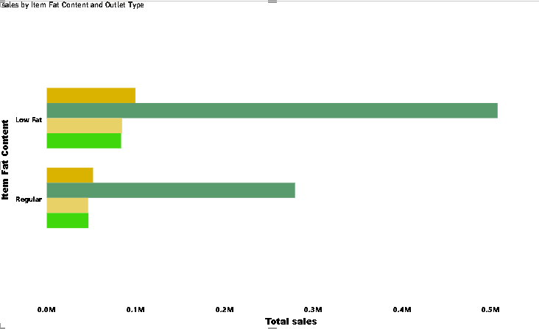
SALES BY ITEM FAT CONTENT AND OUTLET TYPE
Supermarket Type1 had the highest total Total sales at 787,549.89, followed by Grocery Store, Supermarket Type2, and Supermarket Type3.
Low Fat in Outlet Type Supermarket Type1 made up 42.26% of Total sales.
Supermarket Type1 had the highest average Total sales at 393,774.95, followed by Grocery Store, Supermarket Type2, and Supermarket Type3.

Slide 9
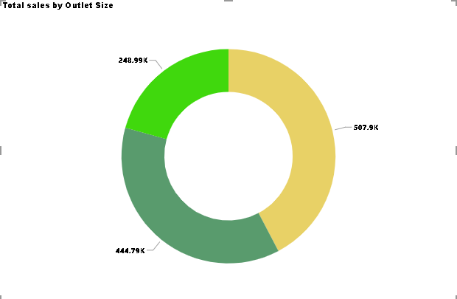
TOTAL SALES BY OUTLET SIZE
Medium had the highest Total sales at 507,895.74, followed by Small at 444,794.17 and High at 248,991.59.
Medium accounted for 42.27% of Total sales.

Slide 10
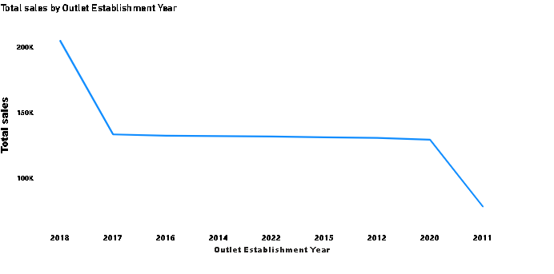
TOTAL SALES BY OUTLET ESTABLISHMENT YEAR
This line chart clearly shows how sales increase significantly from the 2017-2018.

Slide 11
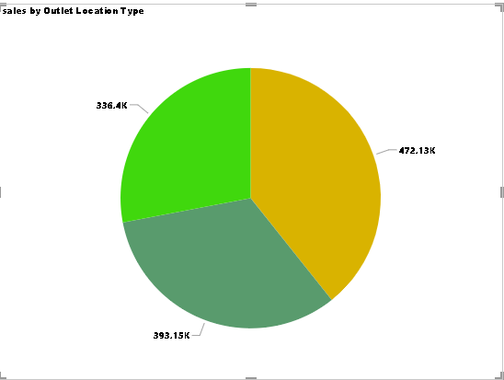
SALES BY OUTLET LOCATION TYPE
Tier 3 had the highest Total sales at 472,133.03, followed by Tier 2 at 393,150.65 and Tier 1 at 336,397.81.
Tier 3 accounted for 39.29% of Total sales.

Slide 12
RECOMMENDATIONS
To align with consumer preferences and optimize product offerings, management should increase the production of low-fat content items. The data indicates a higher demand for low-fat products compared to regular fat content items. By focusing on expanding the range and availability of low-fat options, management can better meet customer needs, potentially boost sales, and stay competitive in the market.
Given that Fruits and Vegetables have the highest total sales, accounting for 16.68% of total sales and significantly outperforming Soft Drinks, which have the lowest total sales, management should prioritize and expand the offerings of Fruits and Vegetables. To maximize revenue, focus on enhancing the range and promotion of these high-performing items. Additionally, consider strategies to boost sales of lower-performing categories like Soft Drinks to balance the product portfolio and increase overall sales.
Given that Supermarket Type 1 leads in total sales and has the highest average total sales, management should focus on enhancing the product offerings and promotions for Supermarket Type 1 to leverage its strong performance. Specifically, since Low Fat items in Supermarket Type1 account for 42.26% of total sales, consider expanding the range of Low Fat products in this format to further capitalize on their popularity. Additionally, assess and optimize the performance of other store types like Grocery Store, Supermarket Type2, and Supermarket Type3 to replicate the successful strategies used in Supermarket Type1.

Slide 13
RECOMMENDATIONS
Given that Medium-sized items have the highest total sales, accounting for 42.27% of total sales, management should prioritize and expand the Medium category. Focus on increasing the inventory and variety of Medium-sized items to capitalize on their strong sales performance. Additionally, explore strategies to enhance the appeal of Small and High-sized items to boost their sales and achieve a more balanced sales distribution across all categories.
Given the significant increase in sales from 2017 to 2018, management should analyze the factors that contributed to this growth to replicate and build on these successes. Consider leveraging strategies or initiatives from this period that drove sales, and explore opportunities to sustain and further accelerate growth in future periods. Additionally, continue monitoring sales trends to identify and address any emerging patterns or opportunities.
Given that Tier 3 has the highest total sales, accounting for 39.29% of total sales, management should focus on expanding and optimizing Tier 3 offerings to further capitalize on its strong performance. Additionally, evaluate the factors contributing to Tier 3's success and consider applying similar strategies to Tier 2 and Tier 1 to boost their sales performance. Enhancing the visibility and appeal of all tiers can help achieve a more balanced and increased overall sales distribution.

Slide 14
THANK YOU

